Slide 1


포트폴리오
2019775068 하수빈

Slide 2
>>
목차
1
main
5
hobby
2
profile
6
favorite
3
education
7
etc..
4
skill
8
정리

Slide 3
1
MainPage

Slide 4
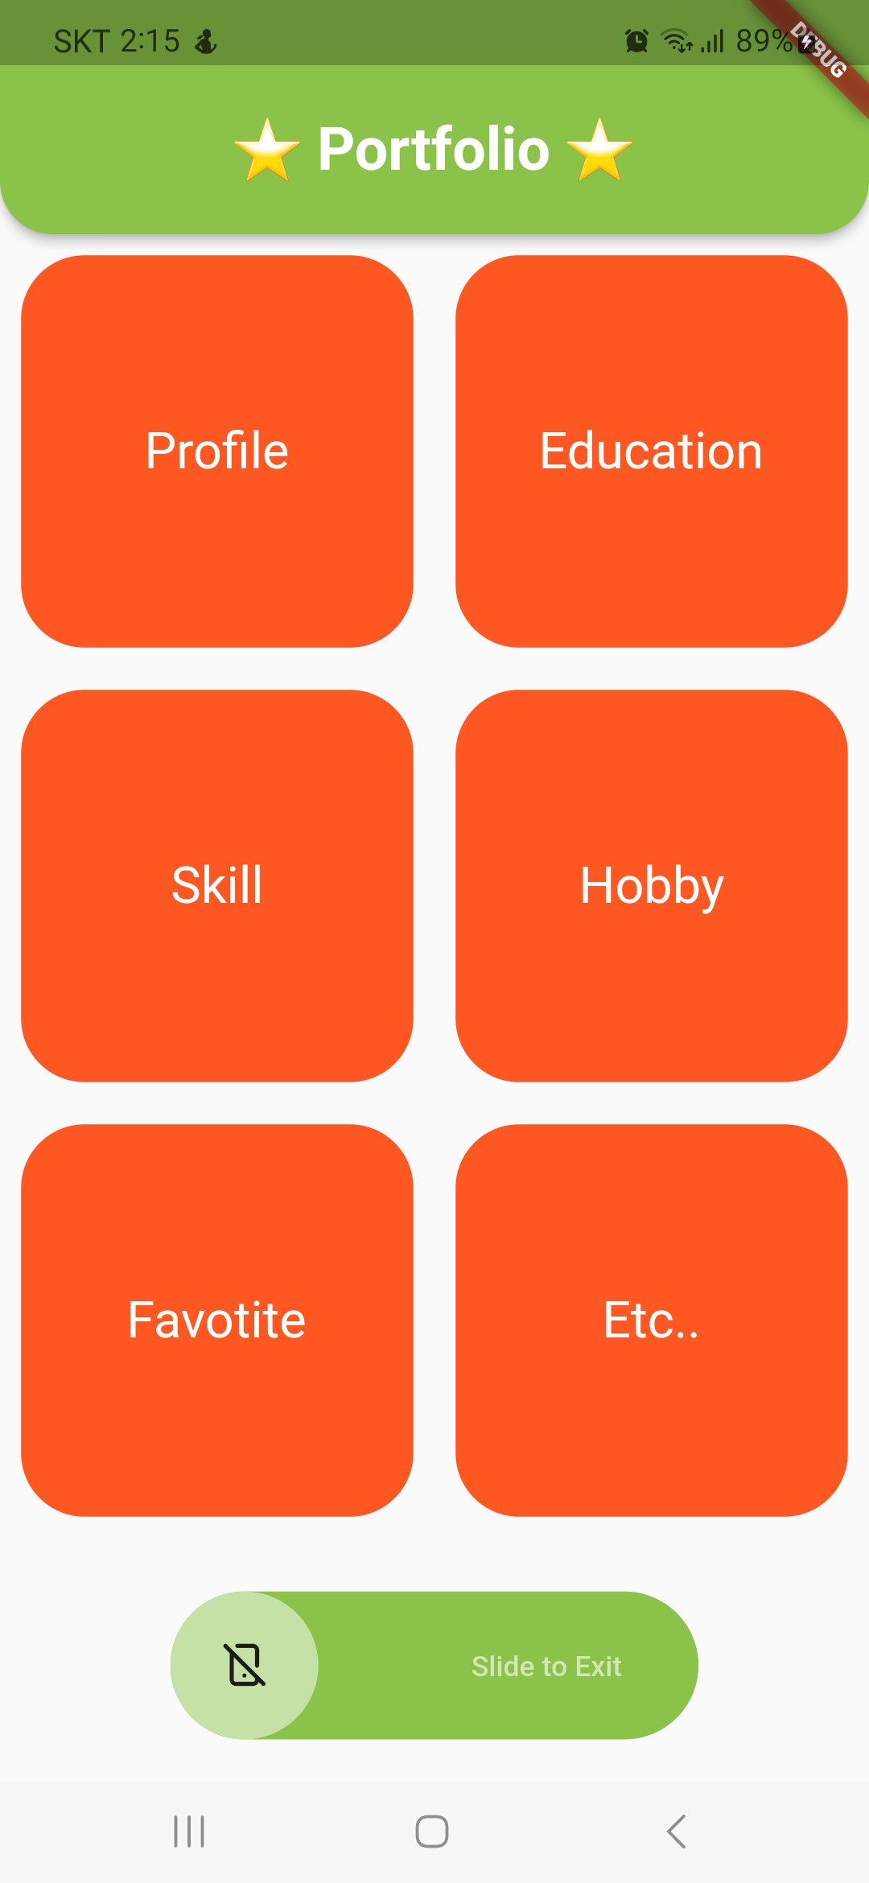
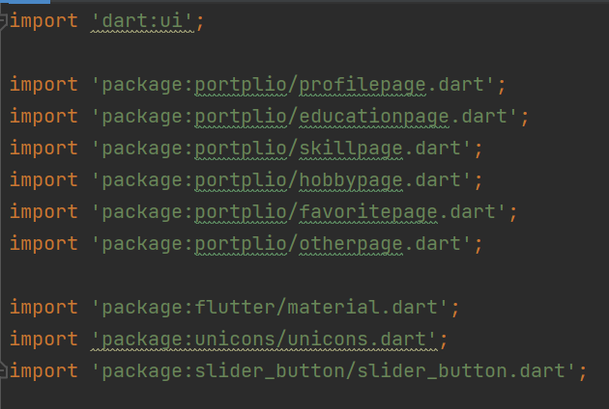
main.dart
각 페이지로 이동
페이지 하단의 슬라이드 버튼
GridView를 이용해 2*3 배열로 만듦 클릭 시 각 페이지로 이동
slider_button package 사용
버튼 슬라이드 시 화면 꺼짐

Slide 5
2
profile.dart

Slide 6
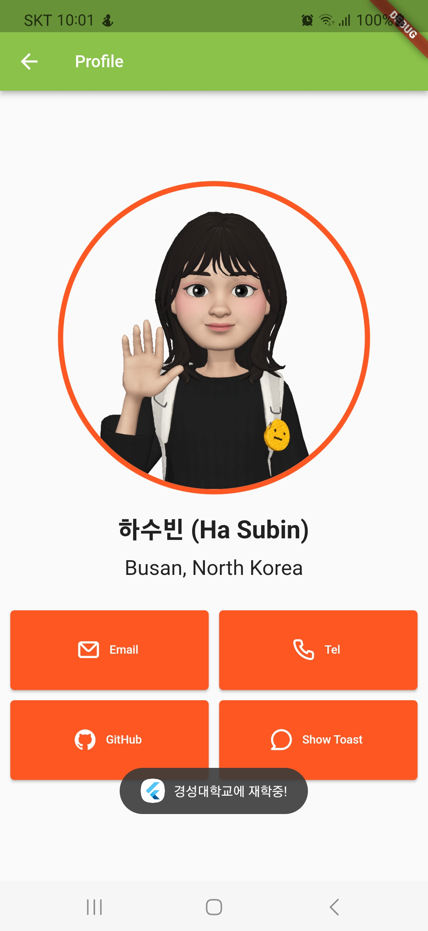
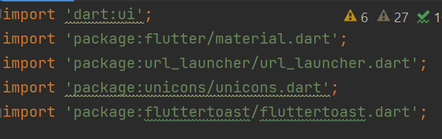
profilepage.dart
gif 이미지
url launcher package, unicon package 사용
이메일 버튼 클릭 시 G-mail로 실행
전화 버튼 클릭 시 전화 앱 실행
깃허브 버튼 클릭 시 깃허브 페이지로 이동
fluttertoast package 사용

Slide 7
3
education.dart

Slide 8
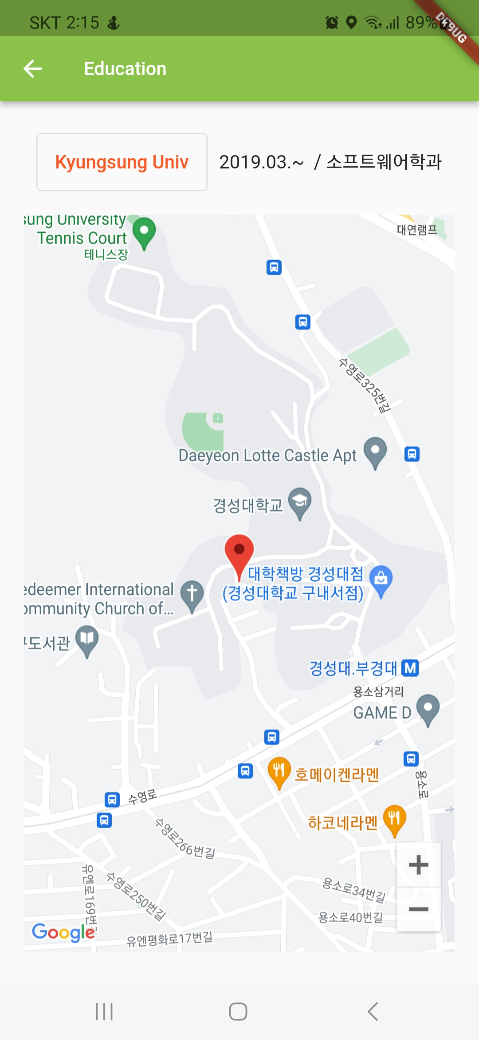
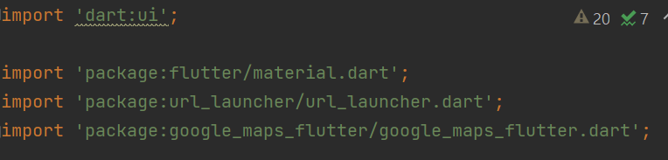
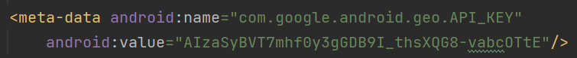
educationpage.dart
url_launcher package 사용
경성대학교 홈페이지로 이동
google map API, google_maps_flutter package 사용
app/src/main/AndroidManifest.xml

Slide 9
4
skill.dart

Slide 10
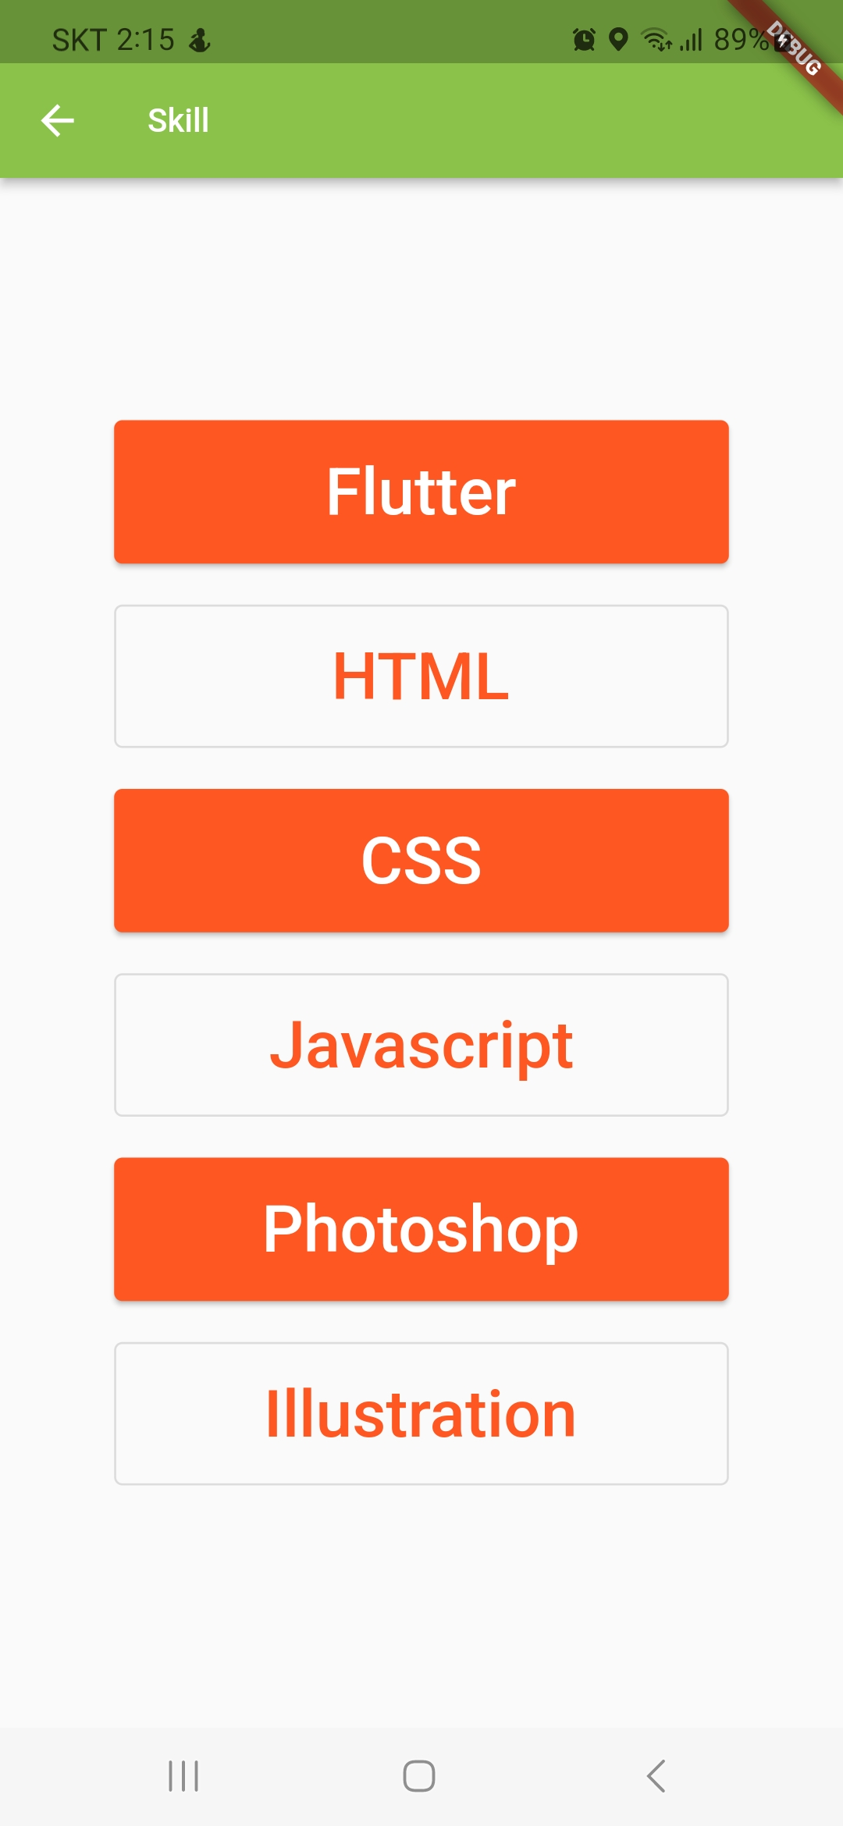
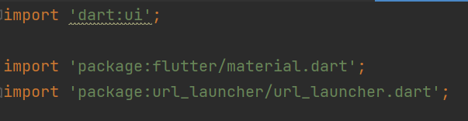
skillpage.dart
url_launcher package 사용
버튼 클릭 시 각각의 홈페이지로 이동

Slide 11
5
hobby.dart

Slide 12
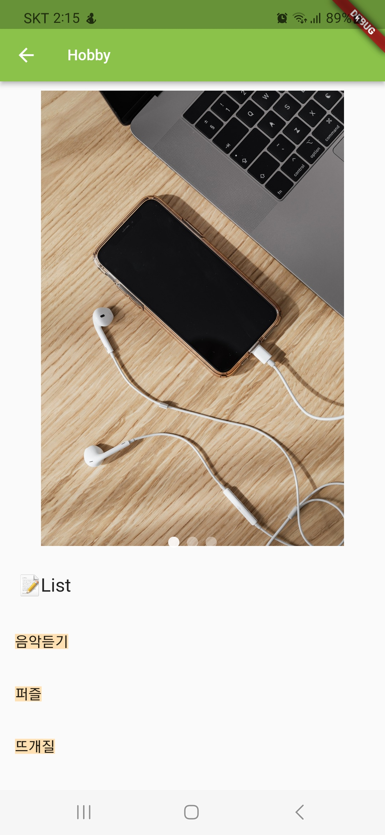
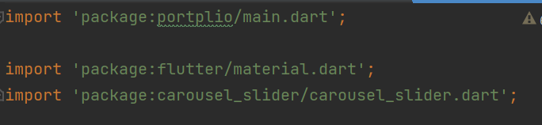
hobbypage.dart
carousel_slider package 사용
2초마다 이미지 변경
ListView 사용

Slide 13
6
favorite.dart

Slide 14
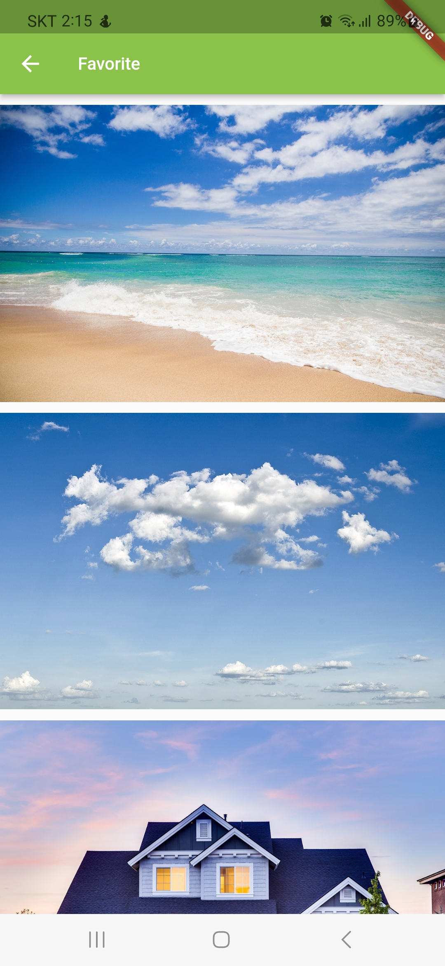
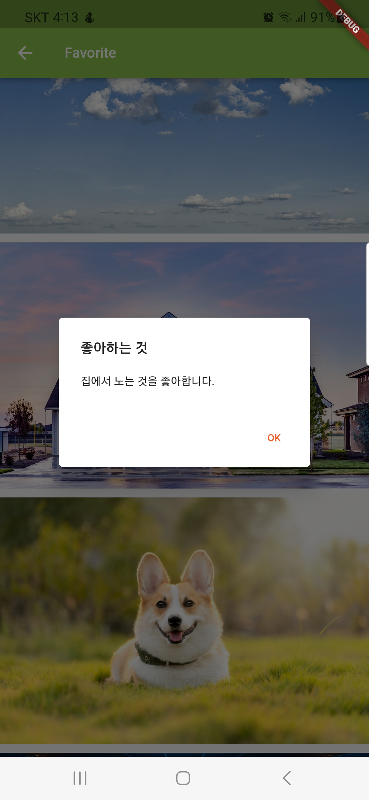
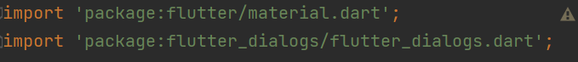
favoritepage.dart
ListView 사용 → 이미지 잘림 해결
flutter_dialogs package 사용
이미지 클릭 시 dialog 나타남 ok 클릭 시 dialog 닫힘

Slide 15
7
other.dart

Slide 16
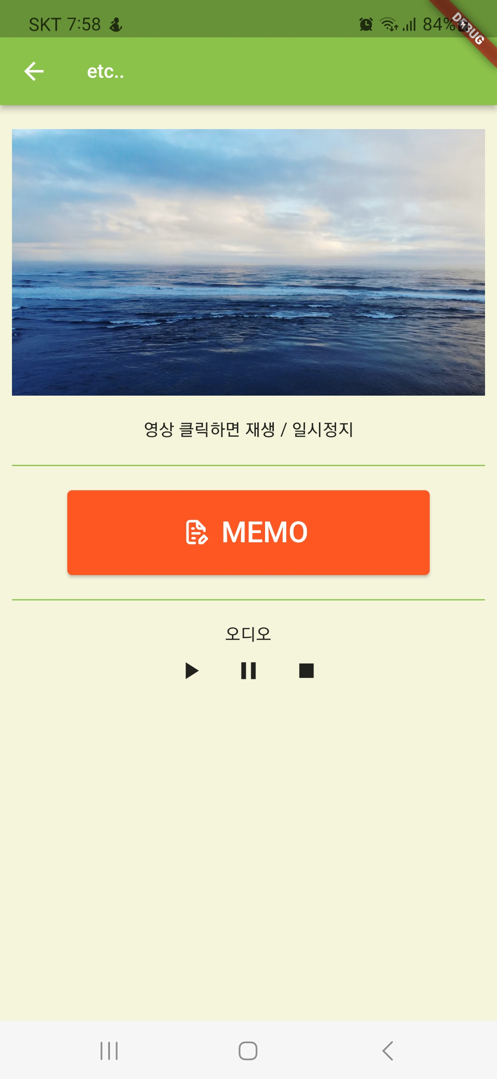
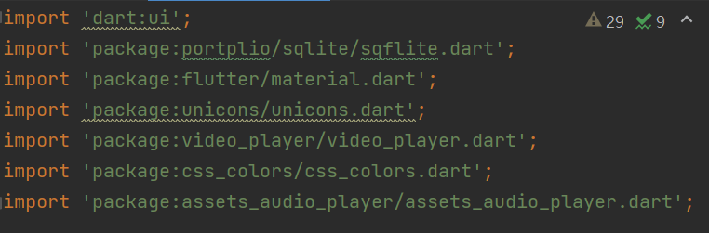
otherpage.dart
video_player package 사용
영상 클릭 시 재생/일시정지
unicon package 사용
버튼 클릭 시 sqflite.dart 페이지로 이동
assets_audio_player package 사용
오디오 재생/일시정지/정지
css_colors package 사용
배경색을 베이지로 변경

Slide 17
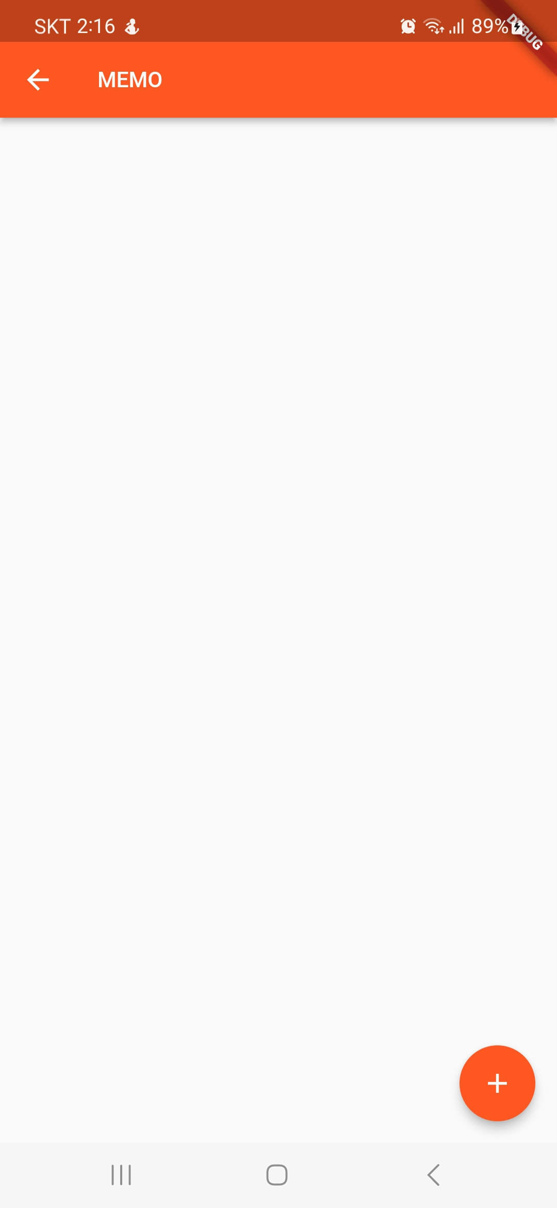
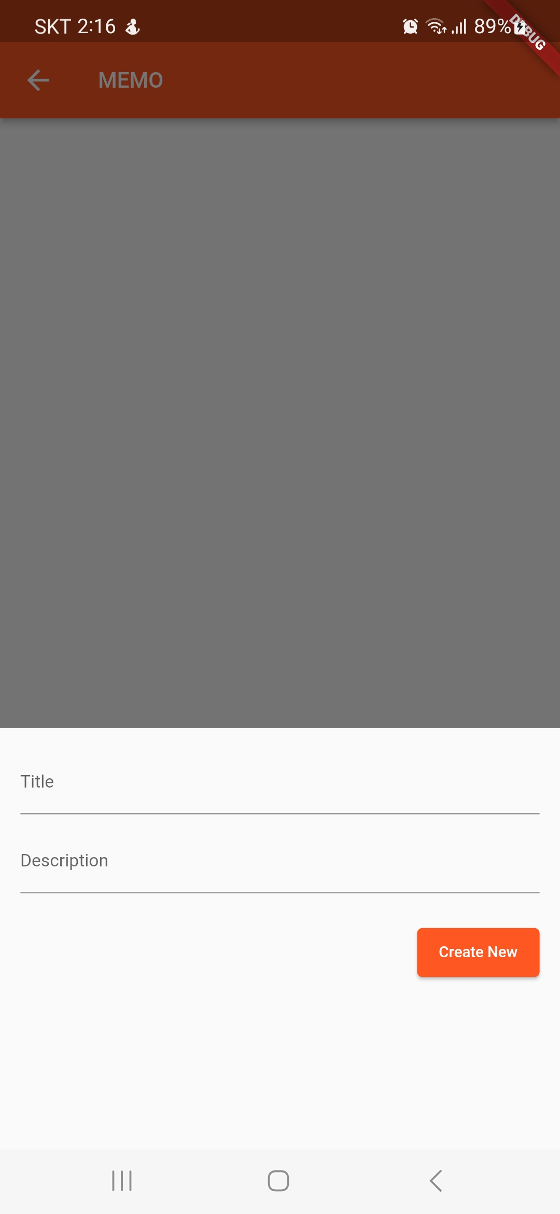
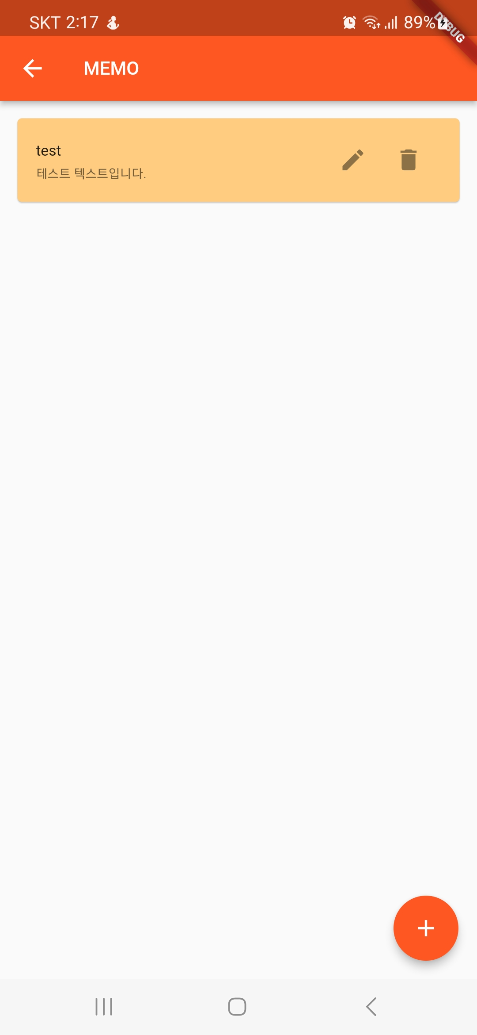
sqflite.dart / sql_helper.dart
data가 입력된 것을 확인할 수 있음
삭제
내용 입력 후 create now 버튼 클릭
수정
버튼 클릭 시 data 추가

Slide 18
8
정리

Slide 19
>> 사용한 package와 API
1. import 'package:url_launcher/url_launcher.dart';
2. import 'package:unicons/unicons.dart';
3. import 'package:fluttertoast/fluttertoast.dart';
4. import 'package:google_maps_flutter/google_maps_flutter.dart';
5. import 'package:slider_button/slider_button.dart';
6. import 'package:flutter_dialogs/flutter_dialogs.dart';
7. import 'package:video_player/video_player.dart';
8. import 'package:carousel_slider/carousel_slider.dart';
9. import 'package:css_colors/css_colors.dart';
10. import 'package:assets_audio_player/assets_audio_player.dart'; ● Goolge Map API
>> 실행영상 및 Github
실행영상 (Youtube)
Github branch -> portfolio (ks2019775068)

Slide 20
감사합니다
뒷장부터는 소스코드입니다.

Slide 21
main.dart
import 'dart:ui';
import 'package:portplio/profilepage.dart';
import 'package:portplio/educationpage.dart';
import 'package:portplio/skillpage.dart';
import 'package:portplio/hobbypage.dart';
import 'package:portplio/favoritepage.dart';
import 'package:portplio/otherpage.dart';
import 'package:flutter/material.dart';
import 'package:unicons/unicons.dart';
import 'package:slider_button/slider_button.dart';
void main() {
runApp(const MyApp());
}
class MyApp extends StatelessWidget {
const MyApp({Key? key}) : super(key: key);
// This widget is the root of your application.
@override
Widget build(BuildContext context) {
return MaterialApp(
title: '포트폴리오',
theme: ThemeData(
primarySwatch: Colors.deepOrange,
),
home: DashboardPage(),
);
}
}
class DashboardPage extends StatelessWidget {
const DashboardPage({Key? key}) : super(key: key);
@override
Widget build(BuildContext context) {
return Scaffold(
appBar: AppBar(
toolbarHeight: 80,
title: Text(
'⭐ Portfolio ⭐',
style: TextStyle(fontSize: 35,
fontWeight: FontWeight.bold)),
centerTitle: true,
backgroundColor: Colors.lightGreen,
shape: RoundedRectangleBorder(
borderRadius: BorderRadius.only(
bottomLeft: Radius.circular(25),
bottomRight: Radius.circular(25),
),
),
),
body: Column(
children: [
Expanded(
child: GridView.count(
crossAxisCount: 2,
children: List.generate(6, (index) {
return GestureDetector(
onTap: () {
switch (index) {
case 0:
Navigator.push(
context,
MaterialPageRoute(
builder: (context) => ProfilePage(),
),
);
break;
case 1:
Navigator.push(
context,
MaterialPageRoute(
builder: (context) => EducationPage(),
),
);
break;
case 2:
Navigator.push(
context,
MaterialPageRoute(
builder: (context) => SkillPage(),
),
);
break;
case 3:
Navigator.push(
context,
MaterialPageRoute(
builder: (context) => HobbyPage(),
),
);
break;
case 4:
Navigator.push(
context,
MaterialPageRoute(
builder: (context) => FavoritePage(),
),
);
break;
case 5:
Navigator.push(
context,
MaterialPageRoute(
builder: (context) => OtherPage(),
),
);
break;
}
},

Slide 22
child: Container(
margin: EdgeInsets.all(10),
decoration: BoxDecoration(
color: Colors.deepOrange,
borderRadius: BorderRadius.circular(30),
),
child: Center(
child: Text(
getTitle(index),
style: TextStyle(
fontSize: 30,
color: Colors.white,
),
),
),
),
);
}),
),
),
SliderButton(
action: () {
///Do something here
Navigator.of(context).pop();
},
label: Text(
"Slide to Exit",
style: TextStyle(
color: Color(0xff4a4a4a),
fontWeight: FontWeight.w500,
fontSize: 17,
),
),
icon: Icon(UniconsLine.android_phone_slash),
baseColor: Colors.white60,
backgroundColor: Colors.lightGreen,
buttonColor: Colors.lightGreen.shade200,
),
SizedBox(height: 20),
],
),
);
}
String getTitle(int index) {
switch (index) {
case 0:
return 'Profile';
case 1:
return 'Education';
case 2:
return 'Skill';
case 3:
return 'Hobby';
case 4:
return 'Favotite';
case 5:
return 'Etc..';
default:
return '';
}
}
}

Slide 23
profilepage.dart
import 'dart:ui';
import 'package:flutter/material.dart';
import 'package:url_launcher/url_launcher.dart';
import 'package:unicons/unicons.dart';
import 'package:fluttertoast/fluttertoast.dart';
class MyApp extends StatelessWidget {
const MyApp({Key? key}) : super(key: key);
@override
Widget build(BuildContext context) {
return MaterialApp(
title: '포트폴리오',
theme: ThemeData(
primarySwatch: Colors.deepOrange,
),
home: ProfilePage(),
);
}
}
class ProfilePage extends StatelessWidget {
@override
Widget build(BuildContext context) {
return Scaffold(
appBar: AppBar(
title: Text('Profile'),
backgroundColor: Colors.lightGreen,
),
body: Center(
child: Column(
mainAxisAlignment: MainAxisAlignment.center,
children: [
Container(
width: 300,
height: 300,
decoration: BoxDecoration(
borderRadius: BorderRadius.circular(200),
border: Border.all(
color: Colors.deepOrange,
width: 5.0,
),
),
child: ClipRRect(
borderRadius: BorderRadius.circular(200),
child: Image.asset(
'assets/images/profile_picture.gif',
fit: BoxFit.cover,
),
),
),
SizedBox(height: 20),
Text(
'하수빈 (Ha Subin)', // 자신의 이름으로 변경해주세요.
style: TextStyle(fontSize: 30, fontWeight: FontWeight.bold),
),
SizedBox(height: 10),
Text(
'Busan, North Korea', // 사는 곳
style: TextStyle(fontSize: 25),
),
SizedBox(height: 20),
GridView.count(
crossAxisCount: 2,
shrinkWrap: true,
padding: EdgeInsets.all(10),
childAspectRatio: 2.5,
mainAxisSpacing: 10,
crossAxisSpacing: 10,
children: [
ElevatedButton.icon(
onPressed: () async {
final url = Uri(
scheme: 'mailto',
path: 'ssub0304@gmail.com',
query: 'subject=Hello&body=Test',
);
if (await canLaunch(url.toString())) {
await launch(url.toString());
} else {
print("Can't launch $url");
}
},
icon: Icon(UniconsLine.envelope),
label: Text("Email"),
style: ButtonStyle(
minimumSize: MaterialStateProperty.all(Size(90, 30)),
),
),
ElevatedButton.icon(
onPressed: () async {
final url = Uri.parse('tel:01012345678');
if (await canLaunch(url.toString())) {
await launch(url.toString());
} else {
print("Can't launch $url");
}
},
icon: Icon(UniconsLine.phone),
label: Text("Tel"),
style: ButtonStyle(
minimumSize: MaterialStateProperty.all(Size(90, 30)),
),
),
ElevatedButton.icon(
onPressed: () async {
final url = Uri.parse(
'https://github.com/ks2019775068',
);
if (await canLaunch(url.toString())) {
await launch(url.toString());
} else {
print("Can't launch $url");
}
},
icon: Icon(UniconsLine.github),
label: Text("GitHub"),
style: ButtonStyle(
minimumSize: MaterialStateProperty.all(Size(90, 30)),
),
),
ElevatedButton.icon(
onPressed: () {
Fluttertoast.showToast(
msg: '경성대학교에 재학중!',
toastLength: Toast.LENGTH_SHORT,
gravity: ToastGravity.BOTTOM,
backgroundColor: Colors.black54,
textColor: Colors.white,
fontSize: 16.0,
);
},
icon: Icon(UniconsLine.comment),
label: Text("Show Toast"),
style: ButtonStyle(
minimumSize: MaterialStateProperty.all(Size(90, 30)),
),
),
],
),
],
),
),
);
}
}

Slide 24
educationpage.dart
import 'dart:ui';
import 'package:flutter/material.dart';
import 'package:url_launcher/url_launcher.dart';
import 'package:google_maps_flutter/google_maps_flutter.dart';
void main() => runApp(MyApp());
class MyApp extends StatelessWidget {
const MyApp({Key? key}) : super(key: key);
@override
Widget build(BuildContext context) {
return MaterialApp(
title: '포트폴리오',
theme: ThemeData(
primarySwatch: Colors.deepOrange,
),
home: EducationPage(),
);
}
}
class EducationPage extends StatelessWidget {
@override
Widget build(BuildContext context) {
return Scaffold(
appBar: AppBar(
title: Text('Education'),
backgroundColor: Colors.lightGreen,
),
body: Center(
child: Column(
mainAxisAlignment: MainAxisAlignment.center,
children: [
SizedBox(width: 10,),
Row(
mainAxisAlignment: MainAxisAlignment.center,
children: [
OutlinedButton(
onPressed: () async {
final uri = Uri.tryParse('https://kscms.ks.ac.kr/kor/Main.do');
if (uri != null) {
launchUrl(uri);
}
},
child: Text(
"Kyungsung Univ",
style: TextStyle(fontSize: 20),
),
style: ButtonStyle(
minimumSize: MaterialStateProperty.all(Size(100, 50)),
),
),
SizedBox(width: 10,),
Text("2019.03.~ / 소프트웨어학과", style: TextStyle(fontSize: 20)),
],
),
SizedBox(height: 20),
Container(
width: MediaQuery.of(context).size.width * 0.9, // 에뮬레이터 너비의 80%로 설정
height: MediaQuery.of(context).size.height * 0.75, // 원하는 높이로 설정
child: GoogleMap(
initialCameraPosition: CameraPosition(
target: LatLng(35.138875388436375, 129.097380470068),
zoom: 16,
),
markers: {
Marker(
markerId: MarkerId('kyungsung_univ'),
position: LatLng(35.138875388436375, 129.097380470068),
infoWindow: InfoWindow(
title: 'Kyungsung University',
snippet: 'Busan, South Korea',
),
),
},
),
),
],
),
),
);
}
}

Slide 25
skillpage.dart
import 'dart:ui';
import 'package:flutter/material.dart';
import 'package:url_launcher/url_launcher.dart';
void main() => runApp(MyApp());
class MyApp extends StatelessWidget {
const MyApp({Key? key}) : super(key: key);
@override
Widget build(BuildContext context) {
return MaterialApp(
title: '포트폴리오',
theme: ThemeData(
primarySwatch: Colors.deepOrange,
),
home: SkillPage(),
);
}
}
class SkillPage extends StatelessWidget {
const SkillPage({Key? key}) : super(key: key);
@override
Widget build(BuildContext context) {
return Scaffold(
appBar: AppBar(
title: Text('Skill'),
backgroundColor: Colors.lightGreen,
),
body: Center(
child: Column(
mainAxisAlignment: MainAxisAlignment.center,
children:[
ElevatedButton(
onPressed: () async {
final uri = Uri.tryParse('https://flutter.dev/');
if (uri != null) {
launchUrl(uri);
}
},
child: Text(
"Flutter",
style: TextStyle(fontSize: 40),
),
style: ButtonStyle(
minimumSize: MaterialStateProperty.all(Size(300, 70)),
),
),
SizedBox(height: 20),
OutlinedButton(
onPressed: () async {
final uri = Uri.tryParse('https://ko.wikipedia.org/wiki/HTML');
if (uri != null) {
launchUrl(uri);
}
},
child: Text(
"HTML",
style: TextStyle(fontSize: 40),
),
style: ButtonStyle(
minimumSize: MaterialStateProperty.all(Size(300, 70)),
),
),
SizedBox(height: 20),
ElevatedButton(
onPressed: () async {
final uri = Uri.tryParse('https://ko.wikipedia.org/wiki/CSS');
if (uri != null) {
launchUrl(uri);
}
},
child: Text(
"CSS",
style: TextStyle(fontSize: 40),
),
style: ButtonStyle(
minimumSize: MaterialStateProperty.all(Size(300, 70)),
),
),
SizedBox(height: 20),
OutlinedButton(
onPressed: () async {
final uri = Uri.tryParse('https://developer.mozilla.org/ko/docs/Web/JavaScript');
if (uri != null) {
launchUrl(uri);
}
},
child: Text(
"Javascript",
style: TextStyle(fontSize: 40),
),
style: ButtonStyle(
minimumSize: MaterialStateProperty.all(Size(300, 70)),
),
),
SizedBox(height: 20),
ElevatedButton(
onPressed: () async {
final uri = Uri.tryParse('https://www.adobe.com/kr/products/photoshop.html');
if (uri != null) {
launchUrl(uri);
}
},

Slide 26
child: Text(
"Photoshop",
style: TextStyle(fontSize: 40),
),
style: ButtonStyle(
minimumSize: MaterialStateProperty.all(Size(300, 70)),
),
),
SizedBox(height: 20),
OutlinedButton(
onPressed: () async {
final uri = Uri.tryParse('https://www.adobe.com/kr/products/illustrator.html');
if (uri != null) {
launchUrl(uri);
}
},
child: Text(
"Illustration",
style: TextStyle(fontSize: 40),
),
style: ButtonStyle(
minimumSize: MaterialStateProperty.all(Size(300, 70)),
),
),
],
),
),
);
}
}

Slide 27
hobbypage.dart
import 'package:portplio/main.dart';
import 'package:flutter/material.dart';
import 'package:carousel_slider/carousel_slider.dart';
void main() => runApp(MyApp());
class MyApp extends StatelessWidget {
const MyApp({Key? key}) : super(key: key);
@override
Widget build(BuildContext context) {
return MaterialApp(
title: '포트폴리오',
theme: ThemeData(
primarySwatch: Colors.deepOrange,
),
home: HobbyPage(),
);
}
}
class HobbyPage extends StatelessWidget {
const HobbyPage({Key? key}) : super(key: key);
@override
Widget build(BuildContext context) {
return const MaterialApp(title: 'Flutter App', home: HomePage());
}
}
class HomePage extends StatefulWidget {
const HomePage({Key? key}) : super(key: key);
@override
State<HomePage> createState() => _HomePageState();
}
class _HomePageState extends State<HomePage> {
int _current = 0;
final CarouselController _controller = CarouselController();
List imageList = [
'assets/images/earphone.jpg',
'assets/images/knitting.jpg',
'assets/images/puzzle.jpg',
];
@override
Widget build(BuildContext context) {
return Scaffold(
appBar: AppBar(
title: Text('Hobby'),
leading: IconButton(
icon: Icon(Icons.arrow_back),
onPressed: () {
Navigator.push(
context,
MaterialPageRoute(
builder: (context) => DashboardPage()
),
);
},
),
backgroundColor: Colors.lightGreen,
),
body: ListView(
children: [
SizedBox(
height: MediaQuery.of(context).size.height*0.6,
child: Stack(
children: [
sliderWidget(),
sliderIndicator(),
],
),
),
const Padding(
padding: EdgeInsets.all(20),
child: Text(
"📝List",
style: TextStyle(fontSize: 25),
),),
ListView.builder(
shrinkWrap: true,
itemCount: 3, // 취미 목록의 개수
itemBuilder: (context, index) {
return ListTile(
title: Text(
index == 0 ? "음악듣기" : index == 1 ? "퍼즐" : "뜨개질",
style: TextStyle(fontSize: 20, backgroundColor: Colors.orange.shade100),
),
);
},
),
],
shrinkWrap: true,
),
);
}
Widget sliderWidget() {
return CarouselSlider(
carouselController: _controller,
items: imageList.map(
(imgLink) {
return Builder(builder: (context){
return Padding(
padding: const EdgeInsets.all(10),
child: Image.asset(
imgLink,
fit: BoxFit.contain,
),
);
},
);
},
).toList(),
options: CarouselOptions(
height: MediaQuery.of(context).size.height * 0.6,
viewportFraction: 1.0,
autoPlay: true,
autoPlayInterval: const Duration(seconds: 2),
onPageChanged: (index, reason) {
setState(() {
_current = index;
});
},
),
);
}

Slide 28
Widget sliderIndicator() {
return Align(
alignment: Alignment.bottomCenter,
child: Row(
mainAxisAlignment: MainAxisAlignment.center,
children: imageList.asMap().entries.map((entry) {
return GestureDetector(
onTap: () => _controller.animateToPage(entry.key),
child: Container(
width: 12,
height: 12,
margin:
const EdgeInsets.symmetric(vertical: 8.0, horizontal: 4.0),
decoration: BoxDecoration(
shape: BoxShape.circle,
color:
Colors.white.withOpacity(_current == entry.key ? 0.9 : 0.4),
),
),
);
}).toList(),
),
);
}
}

Slide 29
favoritepage.dart
import 'package:flutter/material.dart';
import 'package:flutter_dialogs/flutter_dialogs.dart';
void main() => runApp(MyApp());
class MyApp extends StatelessWidget {
const MyApp({Key? key}) : super(key: key);
@override
Widget build(BuildContext context) {
return MaterialApp(
title: '포트폴리오',
theme: ThemeData(
primarySwatch: Colors.deepOrange,
),
home: FavoritePage(),
);
}
}
class FavoritePage extends StatelessWidget {
void showAlert(BuildContext context, String message) {
showDialog(
context: context,
barrierDismissible: true,
builder: (_) => BasicDialogAlert(
title: Text("좋아하는 것"),
content: Text(message),
actions: <Widget>[
BasicDialogAction(
title: Text("OK"),
onPressed: () {
Navigator.pop(context);
},
),
],
),
);
}
@override
Widget build(BuildContext context) {
return Scaffold(
appBar: AppBar(
title: Text('Favorite'),
backgroundColor: Colors.lightGreen,
),
body: ListView(
children: [
SizedBox(height: 10,),
GestureDetector(
onTap: () {
showAlert(context, '바다를 좋아합니다.');
},
child: Image.asset('assets/images/sea.jpg'),
),
SizedBox(height: 10,),
GestureDetector(
onTap: () {
showAlert(context, '하늘보면서 멍때리는 것을 좋아합니다.');
},
child: Image.asset('assets/images/sky.jpg'),
),
SizedBox(height: 10,),
GestureDetector(
onTap: () {
showAlert(context, '집에서 노는 것을 좋아합니다.');
},
child: Image.asset('assets/images/house.jpg'),
),
SizedBox(height: 10,),
GestureDetector(
onTap: () {
showAlert(context, '동물을 좋아합니다.');
},
child: Image.asset('assets/images/dog.jpg'),
),
SizedBox(height: 10,),
GestureDetector(
onTap: () {
showAlert(context, '영화 보는 것을 좋아합니다.');
},
child: Image.asset('assets/images/movie.jpg'),
),
SizedBox(height: 10,),
],
),
);
}
}

Slide 30
otherpage.dart
import 'dart:ui';
import 'package:portplio/sqlite/sqflite.dart';
import 'package:flutter/material.dart';
import 'package:unicons/unicons.dart';
import 'package:video_player/video_player.dart';
import 'package:css_colors/css_colors.dart';
import 'package:assets_audio_player/assets_audio_player.dart';
void main() => runApp(MyApp());
class MyApp extends StatelessWidget {
const MyApp({Key? key}) : super(key: key);
@override
Widget build(BuildContext context) {
return MaterialApp(
title: '포트폴리오',
theme: ThemeData(
primarySwatch: Colors.deepOrange,
),
home: OtherPage(),
);
}
}
class OtherPage extends StatefulWidget {
@override
_OtherPageState createState() => _OtherPageState();
}
class _OtherPageState extends State<OtherPage> {
late VideoPlayerController _videoPlayerController;
bool _isVideoPlaying = false;
AssetsAudioPlayer _assetsAudioPlayer = AssetsAudioPlayer();
@override
void initState() {
super.initState();
_videoPlayerController = VideoPlayerController.asset('assets/video/seavideo.mp4')
..initialize().then((_) {
setState(() {
_isVideoPlaying = true;
});
});
_assetsAudioPlayer.open(
Audio('assets/bgm.mp3'),
autoStart: false,
);
}
@override
void dispose() {
super.dispose();
_videoPlayerController.dispose();
_assetsAudioPlayer.dispose();
}
void _toggleVideoPlayback() {
setState(() {
if (_videoPlayerController.value.isPlaying) {
_videoPlayerController.pause();
} else {
_videoPlayerController.play();
}
});
}
@override
Widget build(BuildContext context) {
return Scaffold(
appBar: AppBar(
title: Text('etc..'),
backgroundColor: Colors.lightGreen,
),
body: Container(
color: CSSColors.beige,
padding: EdgeInsets.only(top: 20, left: 10, right: 10),
child: Column(
children: [
_isVideoPlaying
? InkWell(
onTap: _toggleVideoPlayback,
child: AspectRatio(
aspectRatio: 16 / 9,
child: VideoPlayer(_videoPlayerController),
),
)
: Text(
'파도영상',
style: TextStyle(fontSize: 24),
),
SizedBox(height: 20),
Text(
'영상 클릭하면 재생 / 일시정지',
style: TextStyle(fontSize: 18),
),
SizedBox(height: 20),
Divider(thickness: 1, height: 1, color: Colors.lightGreen),
SizedBox(height: 20),
ElevatedButton.icon(
onPressed: () {
Navigator.push(
context,
MaterialPageRoute(builder: (context) => HomePage()),
);
},
label: Text("MEMO", style: TextStyle(fontSize: 30)),
icon: Icon(UniconsLine.file_edit_alt),
style: ButtonStyle(
minimumSize: MaterialStateProperty.all(Size(300, 70)),
),
),
SizedBox(height: 20),
Divider(thickness: 1, height: 1, color: Colors.lightGreen),
SizedBox(height: 20),
Text(
'오디오',
style: TextStyle(fontSize: 18),
),
Row(
mainAxisAlignment: MainAxisAlignment.center,
children: [
IconButton(
onPressed: () {
_assetsAudioPlayer.play();
},
icon: Icon(Icons.play_arrow),
),
IconButton(
onPressed: () {
_assetsAudioPlayer.pause();
},
icon: Icon(Icons.pause),
),
IconButton(
onPressed: () {
_assetsAudioPlayer.stop();
},
icon: Icon(Icons.stop),
),
],
),
],
),
),
);
}
}

Slide 31
sqflite.dart
import 'package:flutter/material.dart';
import 'sql_helper.dart';
void main() {
runApp(const MyApp());
}
class MyApp extends StatelessWidget {
const MyApp({Key? key}) : super(key: key);
@override
Widget build(BuildContext context) {
return MaterialApp(
// Remove the debug banner
debugShowCheckedModeBanner: false,
title: 'Memo',
theme: ThemeData(
primarySwatch: Colors.orange,
),
home: const HomePage());
}
}
class HomePage extends StatefulWidget {
const HomePage({Key? key}) : super(key: key);
@override
_HomePageState createState() => _HomePageState();
}
class _HomePageState extends State<HomePage> {
// All journals
List<Map<String, dynamic>> _journals = [];
bool _isLoading = true;
// This function is used to fetch all data from the database
void _refreshJournals() async {
final data = await SQLHelper.getItems();
setState(() {
_journals = data;
_isLoading = false;
});
}
@override
void initState() {
super.initState();
_refreshJournals(); // Loading the diary when the app starts
}
final TextEditingController _titleController = TextEditingController();
final TextEditingController _descriptionController = TextEditingController();
// This function will be triggered when the floating button is pressed
// It will also be triggered when you want to update an item
void _showForm(int? id) async {
if (id != null) {
// id == null -> create new item
// id != null -> update an existing item
final existingJournal =
_journals.firstWhere((element) => element['id'] == id);
_titleController.text = existingJournal['title'];
_descriptionController.text = existingJournal['description'];
}
showModalBottomSheet(
context: context,
elevation: 5,
isScrollControlled: true,
builder: (_) => Container(
padding: EdgeInsets.only(
top: 15,
left: 15,
right: 15,
// this will prevent the soft keyboard from covering the text fields
bottom: MediaQuery.of(context).viewInsets.bottom + 120,
),
child: Column(
mainAxisSize: MainAxisSize.min,
crossAxisAlignment: CrossAxisAlignment.end,
children: [
TextField(
controller: _titleController,
decoration: const InputDecoration(hintText: 'Title'),
),
const SizedBox(
height: 10,
),
TextField(
controller: _descriptionController,
decoration: const InputDecoration(hintText: 'Description'),
),
const SizedBox(
height: 20,
),

Slide 32
void _deleteItem(int id) async {
await SQLHelper.deleteItem(id);
ScaffoldMessenger.of(context).showSnackBar(const SnackBar(
content: Text('Successfully deleted a journal!'),
));
_refreshJournals();
}
@override
Widget build(BuildContext context) {
return Scaffold(
appBar: AppBar(
title: const Text('MEMO'),
),
body: _isLoading
? const Center(
child: CircularProgressIndicator(),
)
: ListView.builder(
itemCount: _journals.length,
itemBuilder: (context, index) => Card(
color: Colors.orange[200],
margin: const EdgeInsets.all(15),
child: ListTile(
title: Text(_journals[index]['title']),
subtitle: Text(_journals[index]['description']),
trailing: SizedBox(
width: 100,
child: Row(
children: [
IconButton(
icon: const Icon(Icons.edit),
onPressed: () => _showForm(_journals[index]['id']),
),
IconButton(
icon: const Icon(Icons.delete),
onPressed: () =>
_deleteItem(_journals[index]['id']),
),
],
),
)),
),
),
floatingActionButton: FloatingActionButton(
child: const Icon(Icons.add),
onPressed: () => _showForm(null),
),
);
}
}
ElevatedButton(
onPressed: () async {
// Save new journal
if (id == null) {
await _addItem();
}
if (id != null) {
await _updateItem(id);
}
// Clear the text fields
_titleController.text = '';
_descriptionController.text = '';
// Close the bottom sheet
Navigator.of(context).pop();
},
child: Text(id == null ? 'Create New' : 'Update'),
)
],
),
));
}
// Insert a new journal to the database
Future<void> _addItem() async {
await SQLHelper.createItem(
_titleController.text, _descriptionController.text);
_refreshJournals();
}
// Update an existing journal
Future<void> _updateItem(int id) async {
await SQLHelper.updateItem(
id, _titleController.text, _descriptionController.text);
_refreshJournals();
}

Slide 33
sql_helper.dart
import 'package:flutter/foundation.dart';
import 'package:sqflite/sqflite.dart' as sql;
class SQLHelper {
static Future<void> createTables(sql.Database database) async {
await database.execute("""CREATE TABLE items(
id INTEGER PRIMARY KEY AUTOINCREMENT NOT NULL,
title TEXT,
description TEXT,
createdAt TIMESTAMP NOT NULL DEFAULT CURRENT_TIMESTAMP
)
""");
}
static Future<sql.Database> db() async {
return sql.openDatabase(
'kindacode.db',
version: 1,
onCreate: (sql.Database database, int version) async {
await createTables(database);
},
);
}
// Create new item (journal)
static Future<int> createItem(String title, String? descrption) async {
final db = await SQLHelper.db();
final data = {'title': title, 'description': descrption};
final id = await db.insert('items', data,
conflictAlgorithm: sql.ConflictAlgorithm.replace);
return id;
}
static Future<List<Map<String, dynamic>>> getItems() async {
final db = await SQLHelper.db();
return db.query('items', orderBy: "id");
}
// Read a single item by id
// The app doesn't use this method but I put here in case you want to see it
static Future<List<Map<String, dynamic>>> getItem(int id) async {
final db = await SQLHelper.db();
return db.query('items', where: "id = ?", whereArgs: [id], limit: 1);
}
// Update an item by id
static Future<int> updateItem(
int id, String title, String? descrption) async {
final db = await SQLHelper.db();
final data = {
'title': title,
'description': descrption,
'createdAt': DateTime.now().toString()
};
final result =
await db.update('items', data, where: "id = ?", whereArgs: [id]);
return result;
}
// Delete
static Future<void> deleteItem(int id) async {
final db = await SQLHelper.db();
try {
await db.delete("items", where: "id = ?", whereArgs: [id]);
} catch (err) {
debugPrint("Something went wrong when deleting an item: $err");
}
}
}

